Slide 1
Implementing and running CO model in g-CTMQC code using OpenMOLCAS for electronic structure calculations
Final Project for Cyber Training Workshop 2022
7/22/22
Julian Stetzler

Slide 2
Objectives
Overall goal: To obtain experience with g-CTMQC code, OpenMOLCAS, and generating/parameterizing PECs
Run dynamics on CO using g-CTMQC
Requires electronic structure calculations which are performed in OpenMOLCAS
Results of electronic structure calculations will be used to parameterize PECs for CO

Slide 3
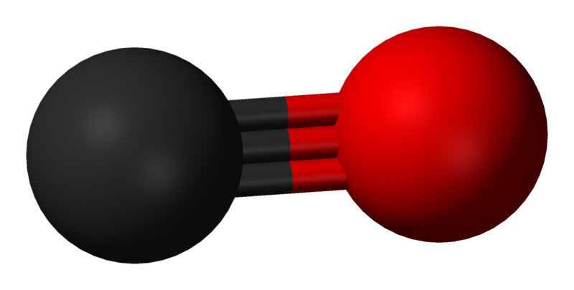
Model and Choice of Method
For the project, the model of interest was carbon monoxide
CO is a simple diatomic with one reaction coordinate and thus easy to parameterize
My research interests include exact factorization and thus the g-CTMQC code is a good choice for dynamics
Requires additional software
Pre-coded potentials
Analytic PES/PEC
g-CTMQC
Electronic Structure Software
Dynamics

Slide 4
Electronic Structure calculations
Molecular Orbital Diagram of CO
OpenMOLCAS with AN0-R3 basis set and (10,11) active space
Equilibrium geometry ground state energy was -113.21 hartrees close to literature value of -113.15 hartrees. SCF orbitals also agreed well with the MO diagram of CO
6σ*
2π*
2p
5σ
2p
1π
4σ*
2s
2s
C
3σ
O
Energy
CO
Peterson, K. and Woods, R., 1990. Theoretical dipole moment functions involving the a 3Π and a’ 3Σ+ states of carbon monoxide. J. Chem. Phys., 93(7), pp.5029-5036

Slide 5
Adibatic PECs
Presence of intruder states in some geometries towards the tail

Slide 6
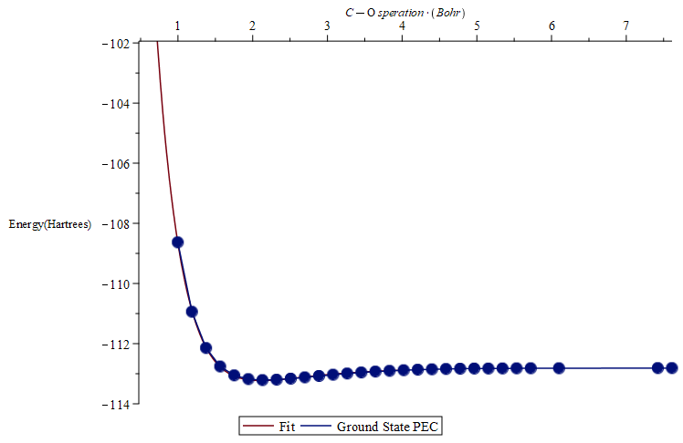
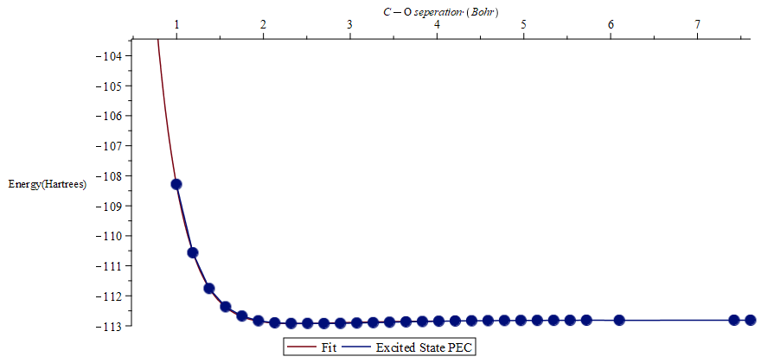
Adibatic PECs fitting
Fitting functions were generic morse oscillators

Slide 7
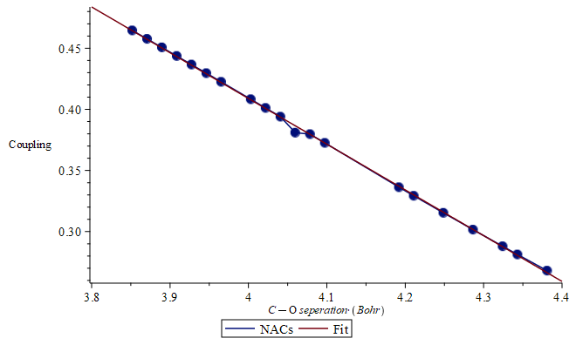
NACs fitting
NACs followed decaying linear trend
Likely needed a larger sample range

Slide 8
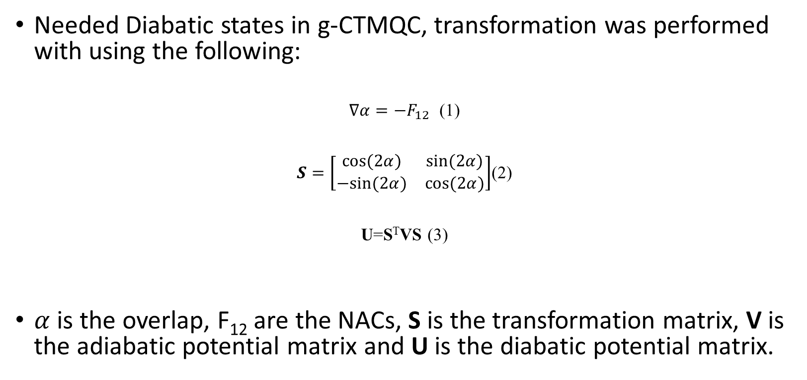
Adiabatic to Diabatic Transformation
Needed Diabatic states in g-CTMQC, transformation was performed with using the following:
$∇α=−F_{12}$ (1)
$S=\left[\begin{matrix}cos⁡(2α) & sin⁡(2α) \\ −sin⁡(2α) & cos⁡(2α)\end{matrix}\right]$(2)
U=S^{T}VS (3)
$α$ is the overlap, F₁₂ are the NACs, S is the transformation matrix, V is the adiabatic potential matrix and U is the diabatic potential matrix.
Köppel, H., 2004. DIABATIC REPRESENTATION: METHODS FOR THE CONSTRUCTION OF DIABATIC ELECTRONIC STATES. Advanced Series in Physical Chemistry, pp.175-204.

Slide 9
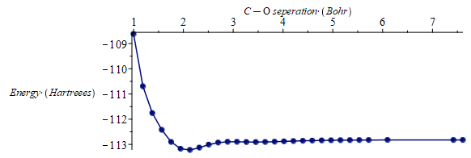
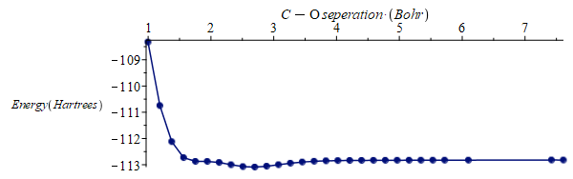
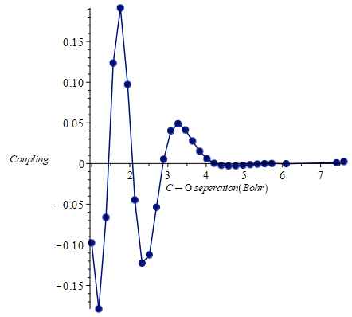
Diabatic Potentials
Ground
Excited
Coupling discovered to not accurate due to incorrect NACs

Slide 10
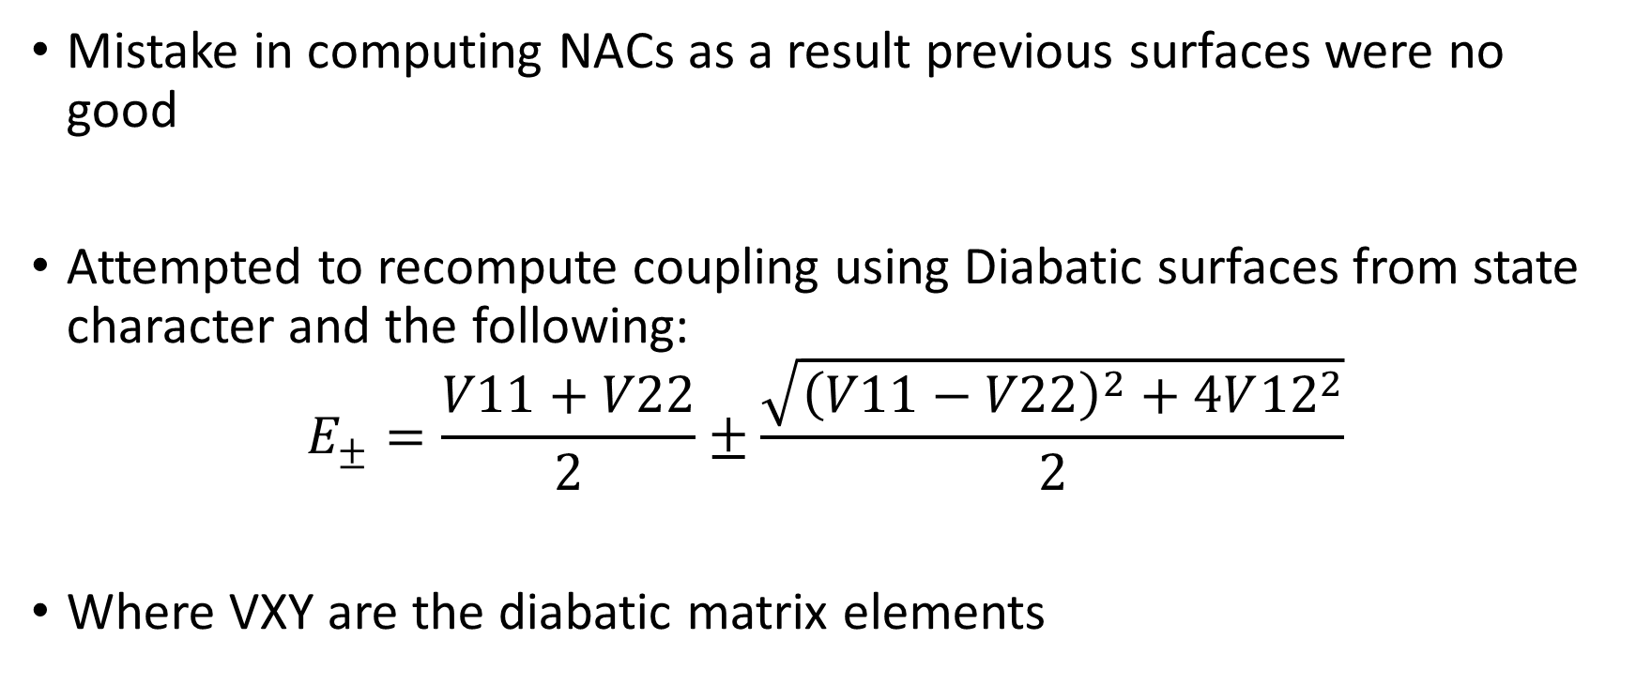
Second Attempt at Diabatic Coupling
Mistake in computing NACs as a result previous surfaces were no good
Attempted to recompute coupling using Diabatic surfaces from state character and the following:
$$E_{±}=\frac{V11+V22}{2}±\frac{\sqrt{{\left(V11−V22\right)}^{2}+4V{12}^{2}}}{2}$$
Where VXY are the diabatic matrix elements
Izmaylov, A. and Franco, I., 2016. Entanglement in the Born–Oppenheimer Approximation. J. Chem. Theory Comput., 13(1), pp.20-28.

Slide 11
Diabatic States Determined by Character
Crossing around 2.6 angstroms or about 5 bohr

Slide 12
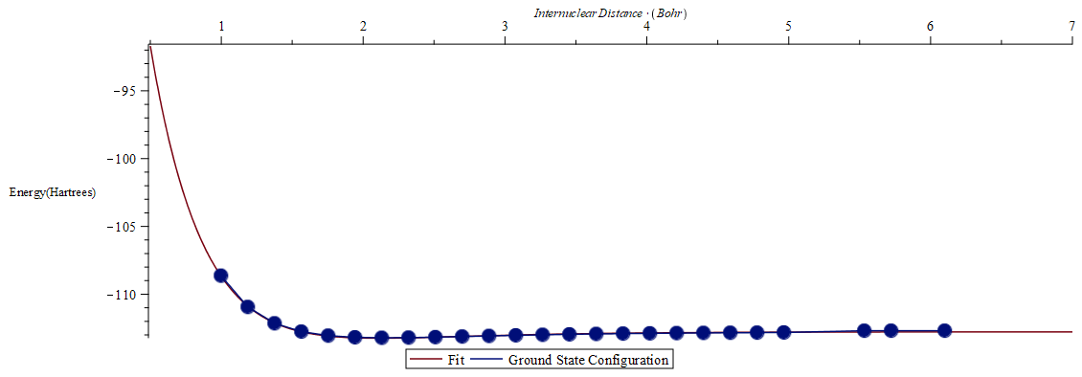
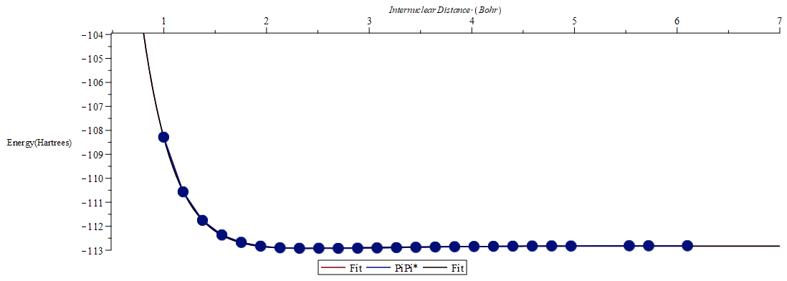
Diabatic Fitting
Fits performed with Morse potentials again

Slide 13
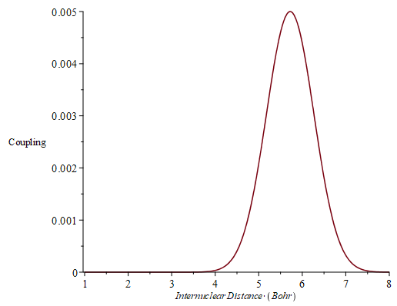
Diabatic Couplings
Diabatic coupling appeared to be gaussian, however, I only had 3 points for fitting.
This likely gets the correct form, but it was difficult to optimize the parameters with so few points
Time-constraints prevented further CASSCF calculations

Slide 14
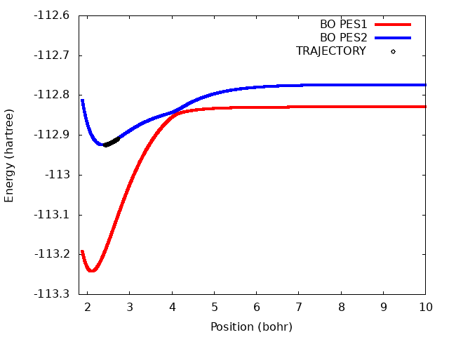
Nuclear Dynamics
CT-MQC
TSHFS
See far less Population transfer in TSHFS
TSHFS Population transfer happens closer to crossing point

Slide 15
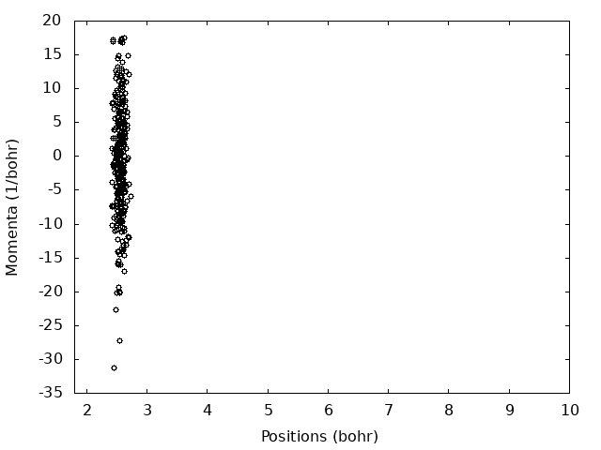
Phasespace
CT-MQC
TSHFS
Phasespace plots appear very similar to each other
Trajectories have high momentum, possibly due to too small of a sigma(despite calculations)

Slide 16
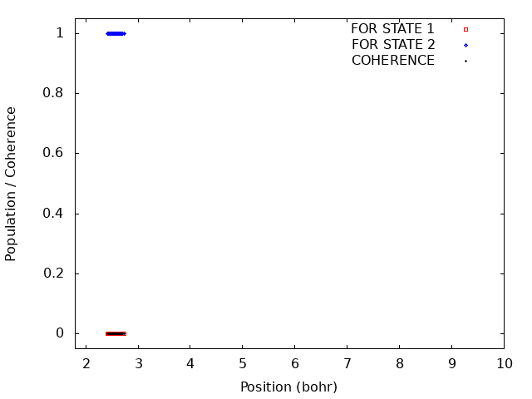
Populations Dynamics
CT-MQC
TSHFS
Populations and Coherences appear to behave similarly

Slide 17
Populations Dynamics
CT-MQC
TSHFS
19
19
Populations and Coherences appear to behave similarly

Slide 18
Conclusion
Obtained some reasonable dynamics results from g-CTMQC for CO
Due to time-constraints unable to fully explore or optimize some parts of the method namely the diabatic transformations
Regardless, did gain valuable experience both using g-CTMQC and OpenMOLCAS, and parameterizing PECs

Slide 19
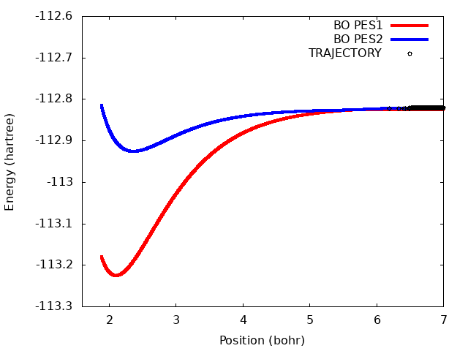
Nuclear Dynamics
CT-MQC
EHREN
TSFSH
CT-MQC and EHREN Behave somewhat similarly
TSFSH has longer lived excited state trajectories

Slide 20
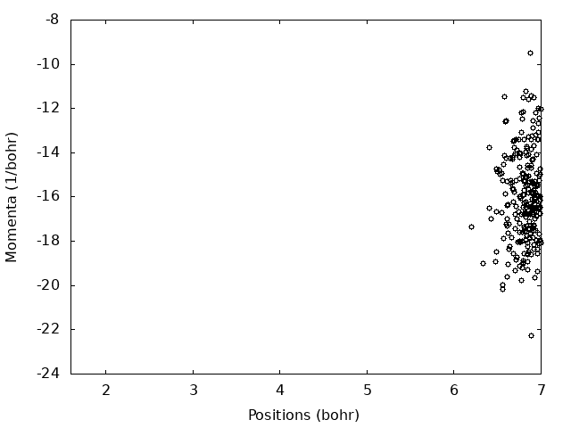
Phasespace
CT-MQC
EHREN
TSFSH
Similar qualitative result for average momentum and position over time
CT-MQC wave packet appears to remain less dispersed compared to Ehrenfest and especially the TSFSH

Slide 21
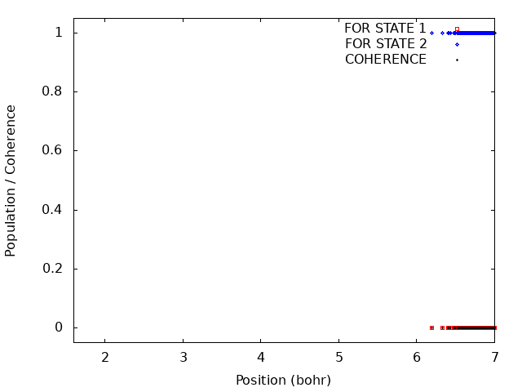
Population Dynamics
CT-MQC
EHREN
TSFSH
Similar coherences correct coupling region
CT-MQC has the fastest population transfer followed by Ehrenfest then TSFSH (similar to what we see in trajectories on the PECs)

Slide 22
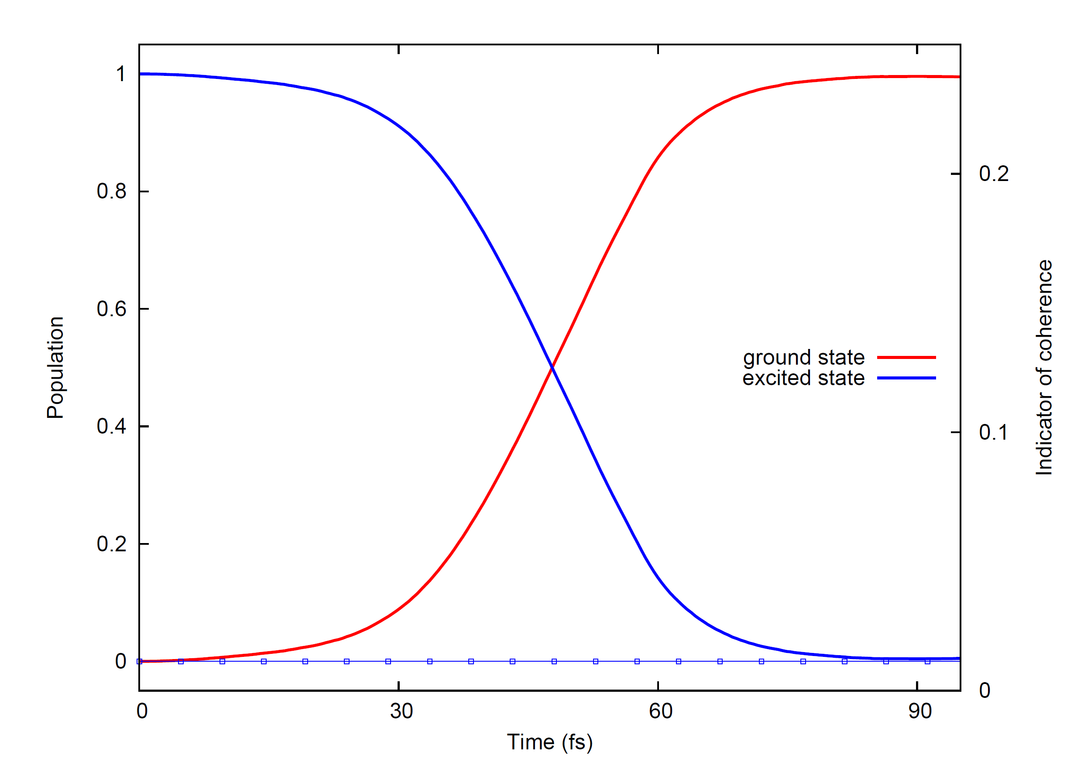
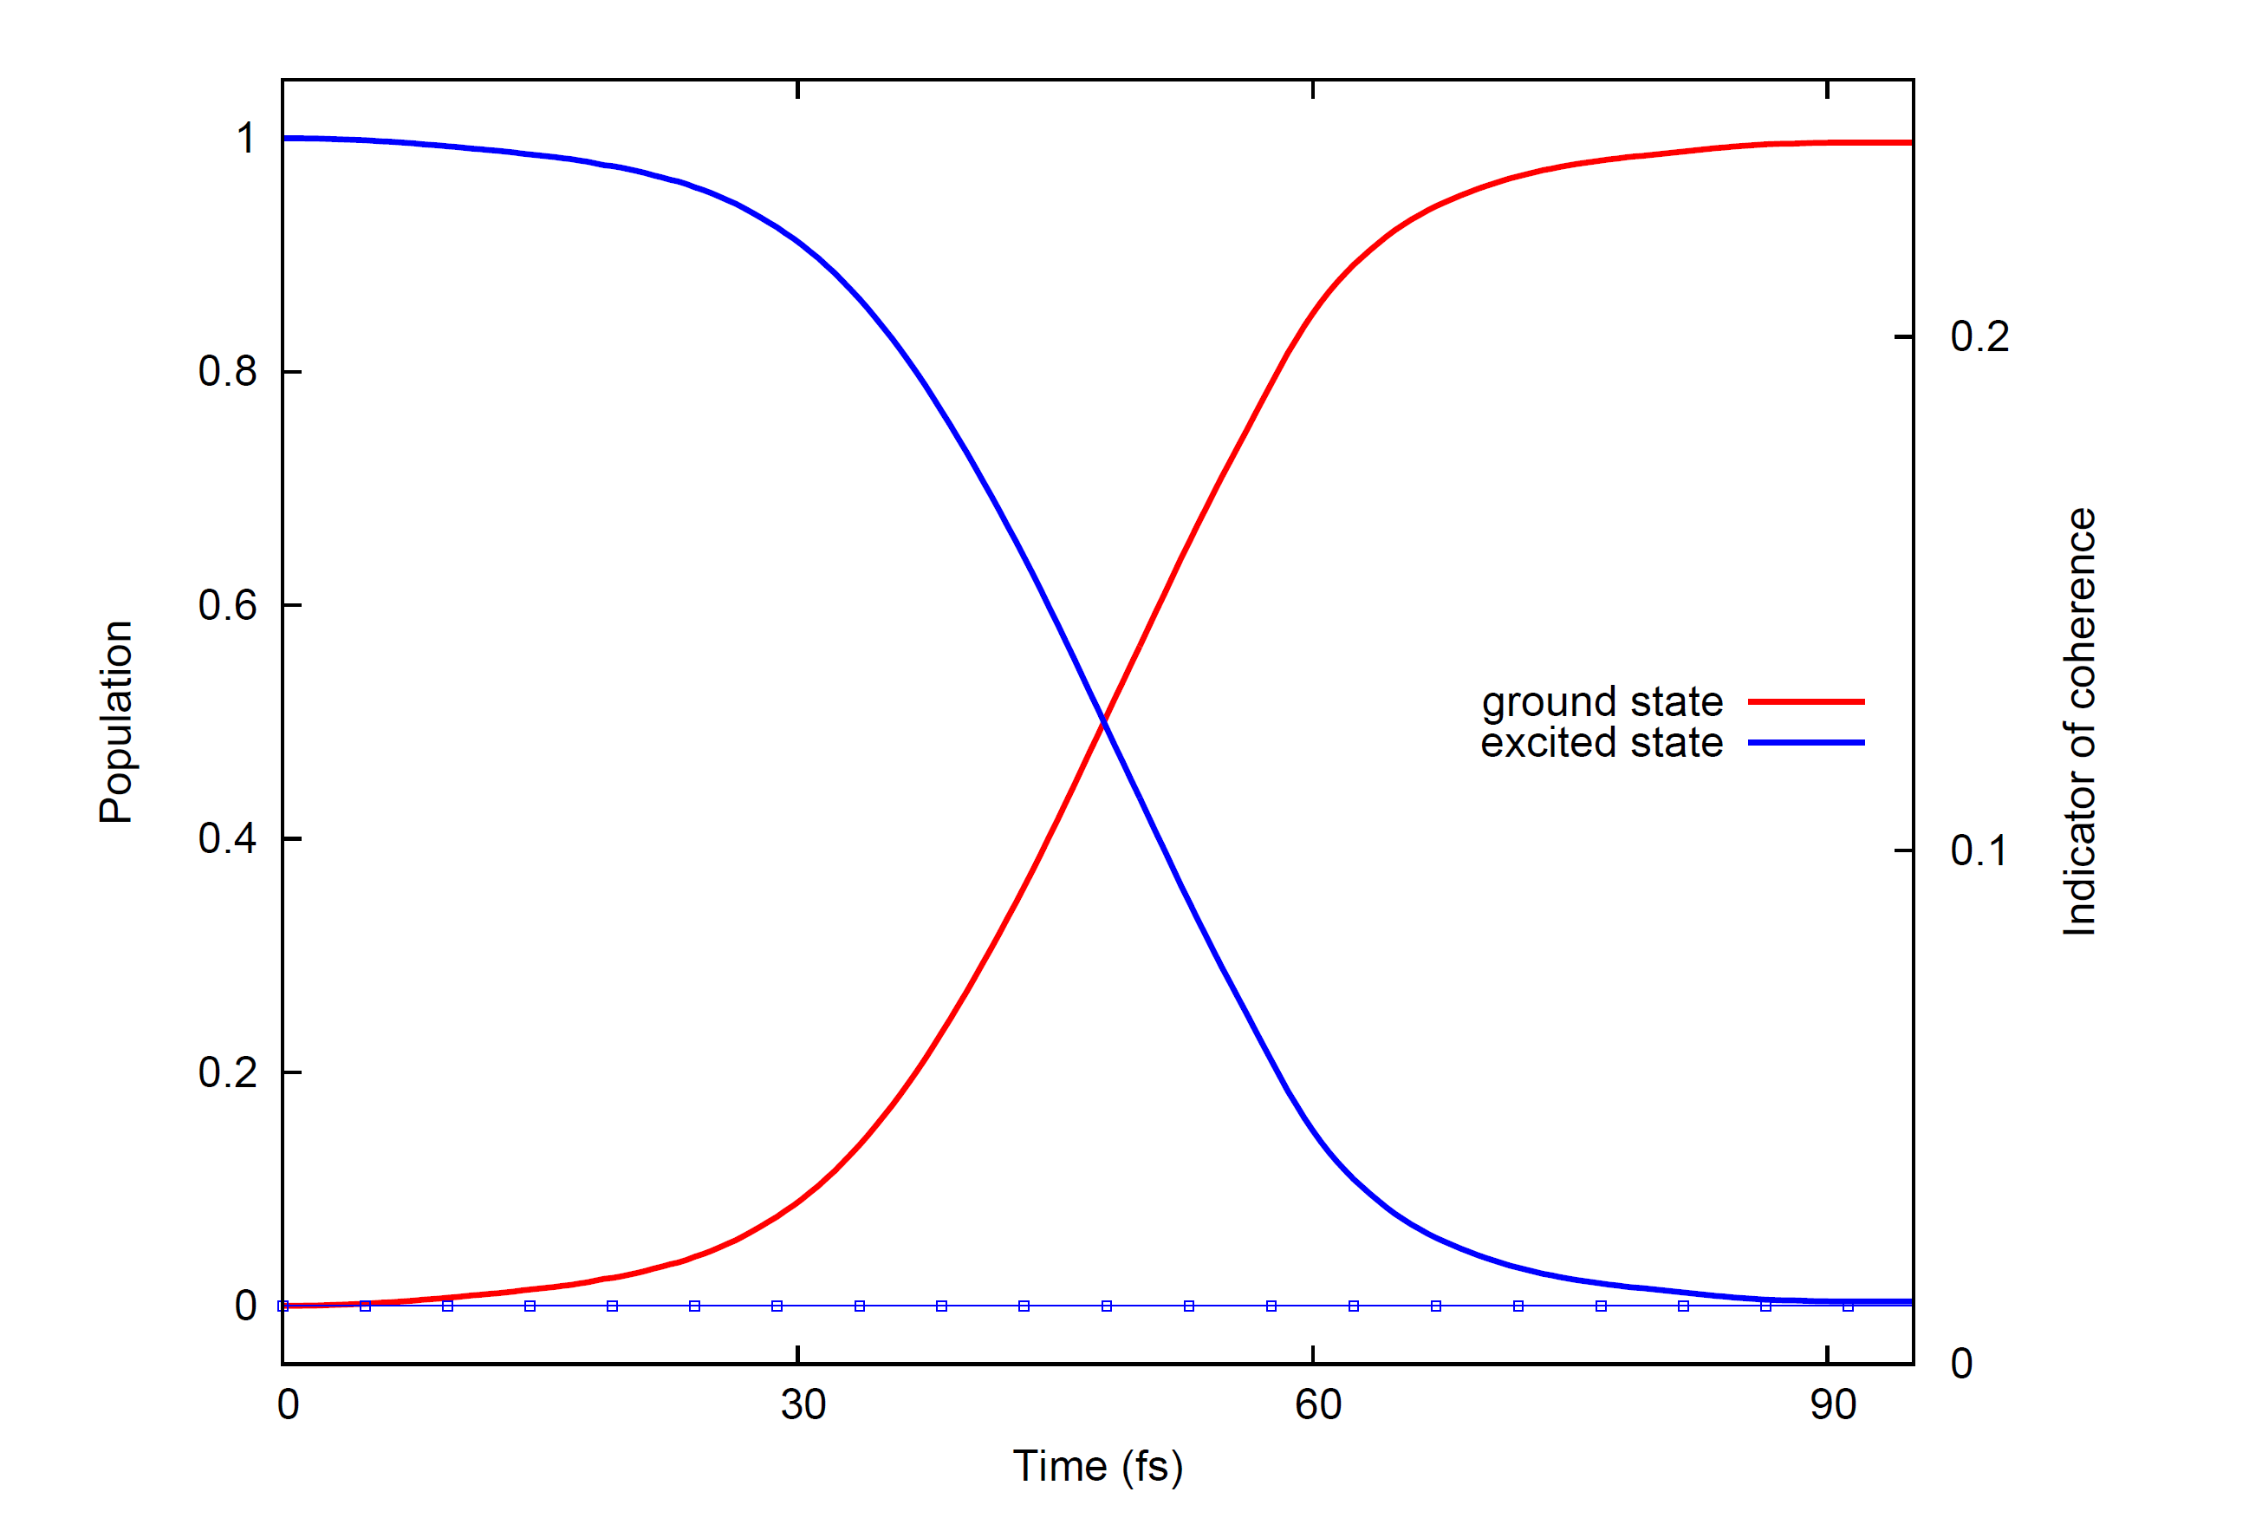
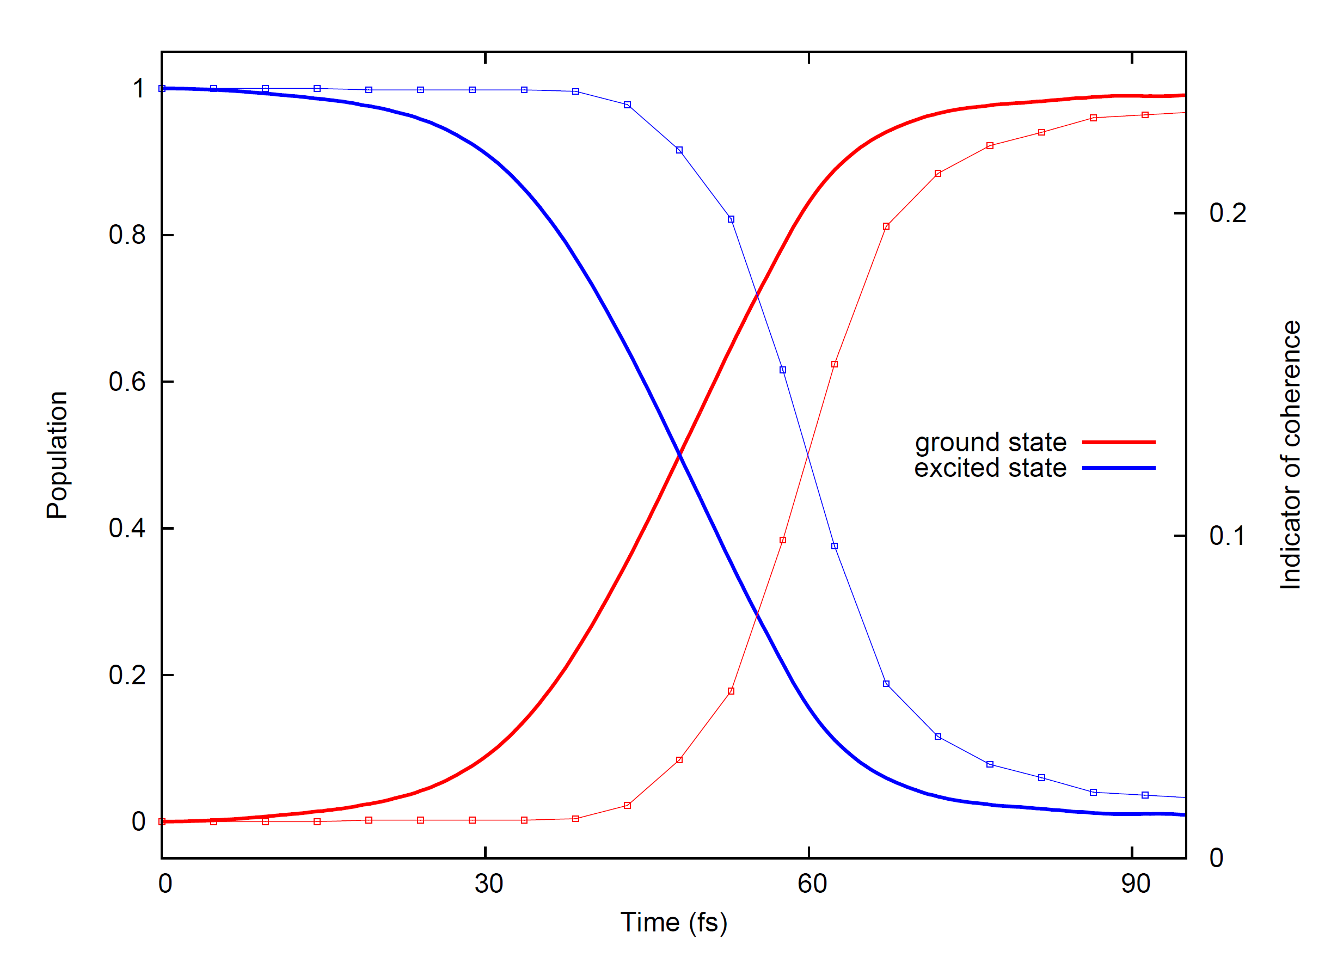
Populations-Backup
CT-MQC
EHREN
TSFSH

